Slide 1
Odoo Inventory Basics
By Katie Dorey

Slide 2
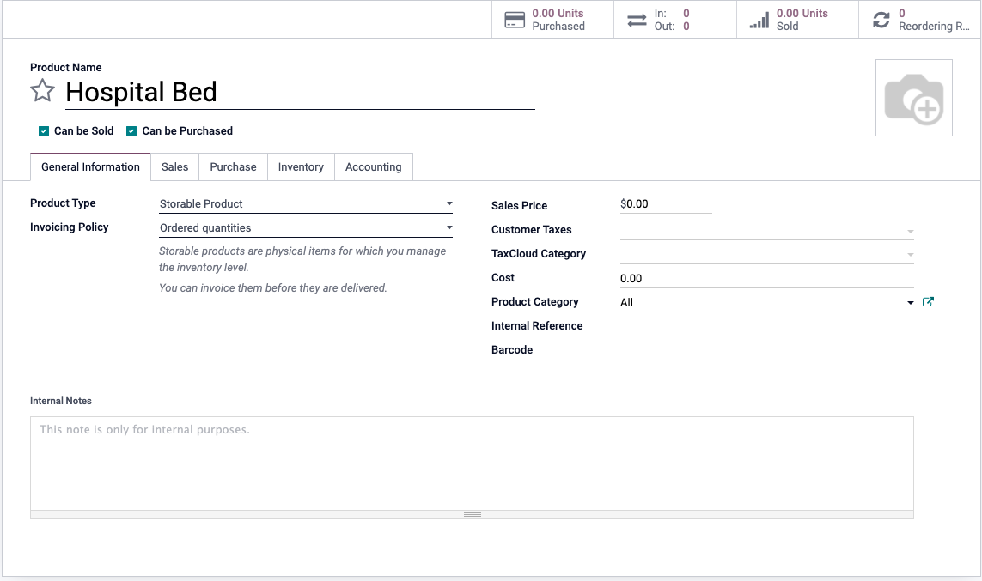
Creating a New Product
Inventory App Product
Key Points:
Product Name
“Can be purchased” and “Can be sold” marked
Product Type
Sales Price
Cost

Slide 3
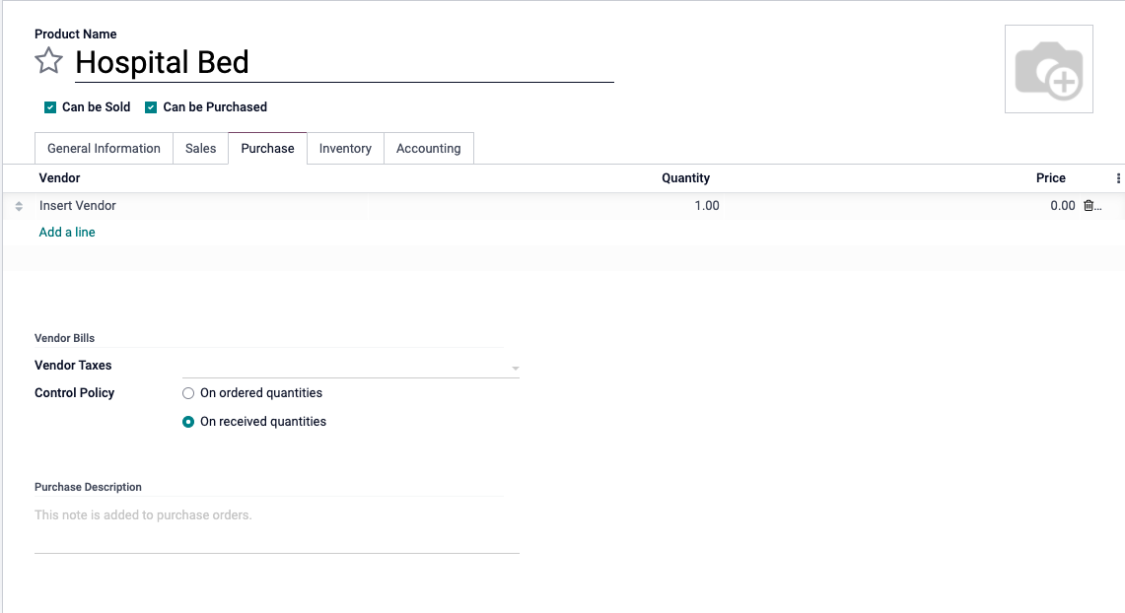
Adding Vendor for Product
Move to “Purchase” tab on product creation screen
Key Points:
Add a line for new vendor
Quantity
Price

Slide 4
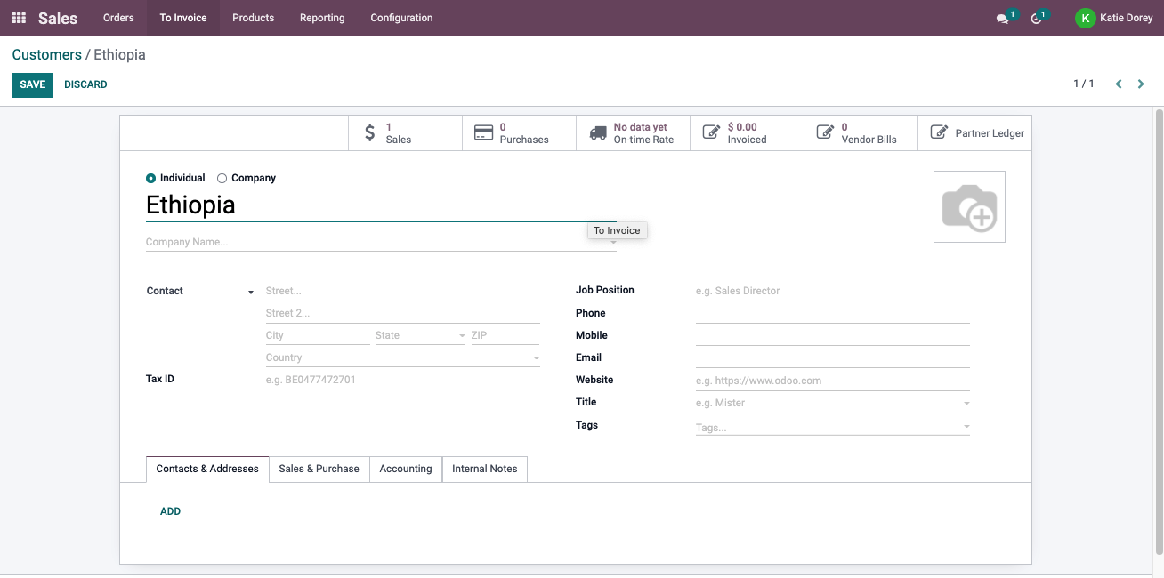
Adding a ‘Customer’ Location
Sales App Orders Customers

Slide 5
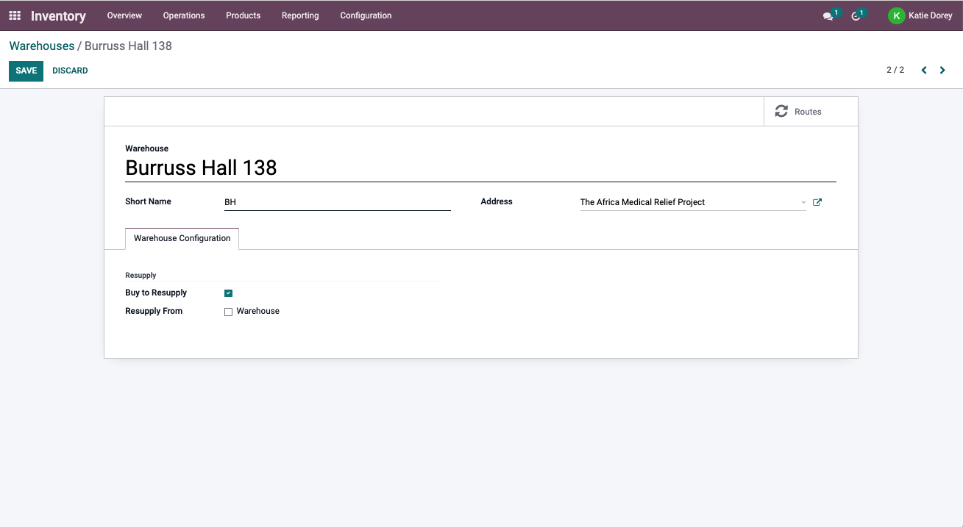
Adding a Warehouse Location
Inventory App Configuration Warehouses

Slide 6
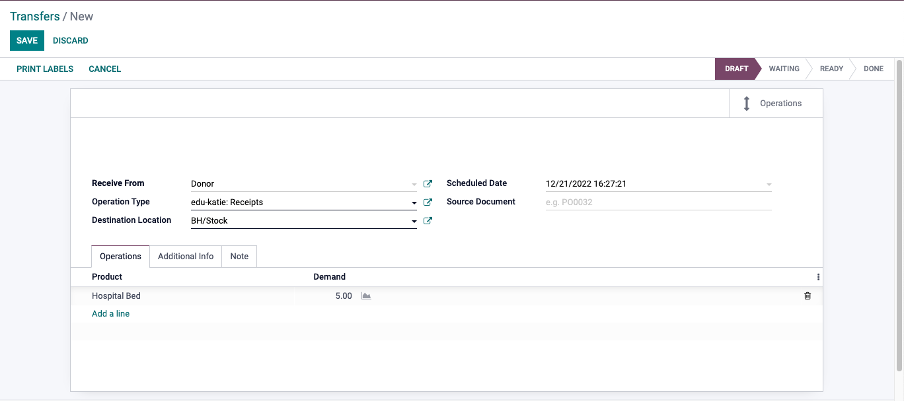
Receiving Products
Inventory App Configuration Warehouses
Key Points:
Receive From: Vendor Name
Operation Type: Receipts
Scheduled date of packing
Add a line for product
Record demand for each product

Slide 7
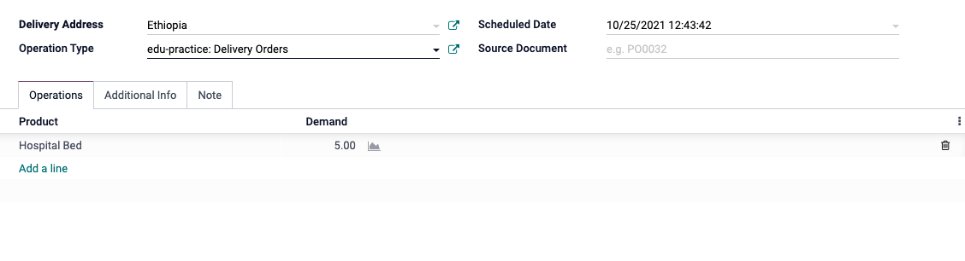
Delivering Products
Inventory app Operations Transfers
Key Points:
Delivery Address
Operation Type: Delivery Orders
Scheduled date of packing
Add a line for product
Record demand for each product

Slide 8
Adjusting Inventory
Inventory App Operations Inventory Adjustments
Key Points:
Select product from dropdown
Record counted quantity

